Slide 1
Agile Approach at ChadaTech
Explaining agile roles
Agile phases
Waterfall model
Waterfall or agile approach
By Asel Shaaeva
CS-250 SDLC

Slide 2
Agile Roles
Each Scrum Team usually consists of
Scrum Master- aids all stakeholders in grasping and internalizing the values, principles and methods of Scrum.
Developer- helps building a high-quality software
Product Owner- is bridge between the development team and the customer. Decides which features and functions are prioritized and developed.
Quality Engineer –part of the development team to tests the software to make sure it is bug free and high-quality

Slide 3
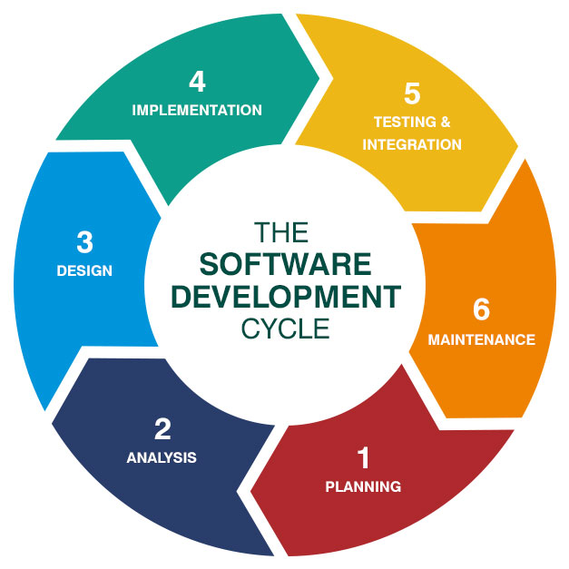
Agile Phases
The phases in SDLC:
Planning – at this stage requirements are gathered
Analysis – is a stage when the requirements get analyzed
Design – is a step when the dev team designs and visualizes the project
Implementation – is a stage where software get built
Testing – is a stage when the QA teams tests the software to make sure it is free from defects and bugs
Maintenance –Once the software gets released it requires a constant maintenance and updates depending on future security or customer needs

Slide 4
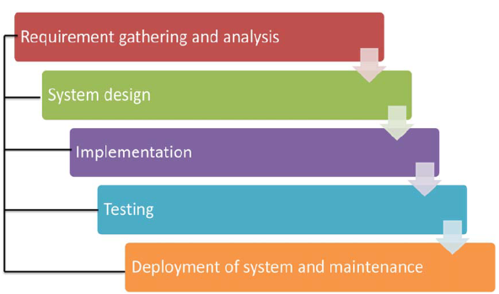
Waterfall Model
“Agile methodologies emerged in the early 2000s, primarily as a response to the limitations of the Waterfall model in software development. The Waterfall model, characterized by its linear and sequential approach, often led to significant challenges in adapting to changing requirements and customer needs (Halani & Jhajharia, 2021)”

Slide 5
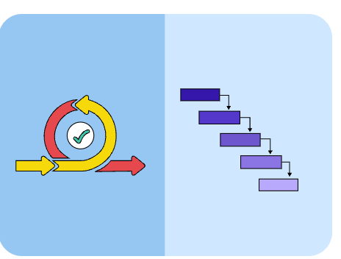
Waterfall or Agile Model?
When it comes to choosing between Waterfall or Agile it probably depends on the company`s needs. But main difference between them is Agile is more flexible in integrating changes versus Waterfall that follows a sequential pattern in SDLC.

Slide 6
References
(PDF) Software Development: Agile vs. traditional. (n.d.). https://www.researchgate.net/publication/269506170_Software_Development_Agile_vs_Traditional
Software development life cycle (SDLC). Big water Consulting. (2024, April 5). https://bigwater.consulting/2019/04/08/software-development-life-cycle-sdlc/
Salimi, S. (2024). Understanding Key Roles in Scrum. Agile Academy. https://www.agile-academy.com/en/foundations/roles-in-scrum/
Lockhart, L. (2023, February 15). Agile vs. Waterfall: 10 Key Differences Between the Two Methods. Www.float.com. https://www.float.com/resources/agile-vs-waterfall
‌
‌

